Slide 1
Not Export Controlled
AIRBUS AMBER
A350 - ATA 36 - PCE Leakage Monitoring
Scoping review
15 Feb 2024
Prasanna RAUT, Akash JADHAV, Juan RODRIGUEZ

Slide 2
A350 ATA 36 : PCE Leakage Monitoring
Scoping review participants
✔
Role | Name & Siglum | Mandatory? | Present? | Comment
Project Leader | David Decouchon | YES | Yes
Operational expert |  |  | No
1SY focal point | Marta Díaz | YES | Yes
Front-End representative / Airtac representative | Heriniaina Rasolofo | YES | Yes
Program / support program / Skywise representative | Yves Dupont |  | Yes
Health Engineer | Prasanna Raut Akash Jadhav Juan RODRIGUEZ | YES | Yes
Design office / EV specialist | Luis Amesty |  | Yes
R&T focal point |  |  | No
Other | María Belén Cuenca |  | Yes
✔

Slide 3
A350 ATA 36 : PCE Leakage Monitoring
Review Meeting Agenda
System Description
Details of work done for current ASR
Leaky Precooler - Evidence
Existing monitoring approach and how its useful?
Need for monitoring at SPM
SAR Data Parameters

Slide 4
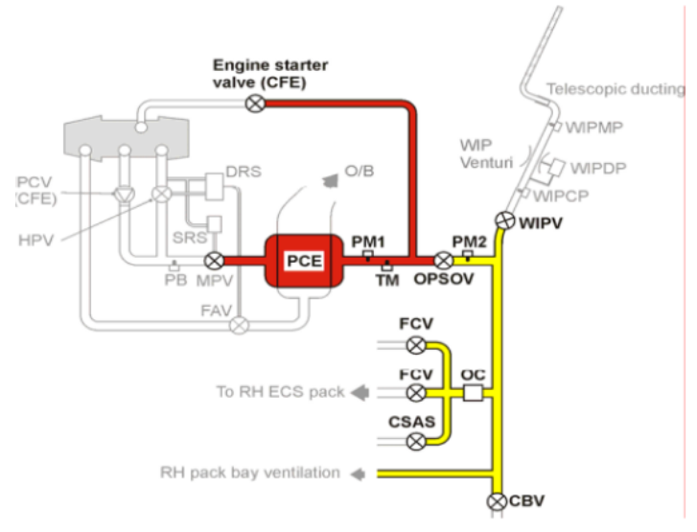
A350 ATA 36 : PCE Leakage Monitoring
System Description
Background:
Pre-Cooler is used to reduce the temperature of engine bleed, before feeding it to Air Generation Unit.
If hot air leaks from pre-cooler it can damage the other components inside pylon.
No active sensor is available to detect air leak from pre-cooler
System Information:
At the end of engine start sequence pressurized air from APU is encapsulated in closed volume as highlighted in the Fig1.
PM1 sensor can be used to measure the pressure.
But all the components are not perfect including PCE(pre-cooler) and valves, hence air leaks out form the gaps reducing pressure gradually.
In case of leaky pre-coolers, air pressure drops drastically which is captured and is detectable by algorithm.
PCE
ATA 6D: 36-11-62
FIN: 7150HA1, 7150HA2
PN: 67200000-02
Supplier:HNW Torrance
Fig1

Slide 5
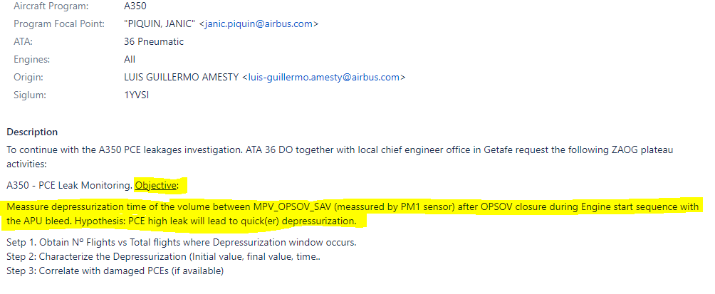
A350 ATA 36 : PCE Leakage Monitoring
https://jira.airbus.corp/browse/SBAOG001-7983
Details of work done for current ASR
Current work is done under the ASR “A350 PCE leakage failures - Monitoring”
Algorithm developed for ASR is validated with real leaky precooler
Analysis is done on A350 fleet for which in-service sensor SAR ch17 data is available on Skywise
  It covers aircrafts from SIA (Singapore Airline), QTR (Qatar Airline) and FIN (Finnair)

Slide 6
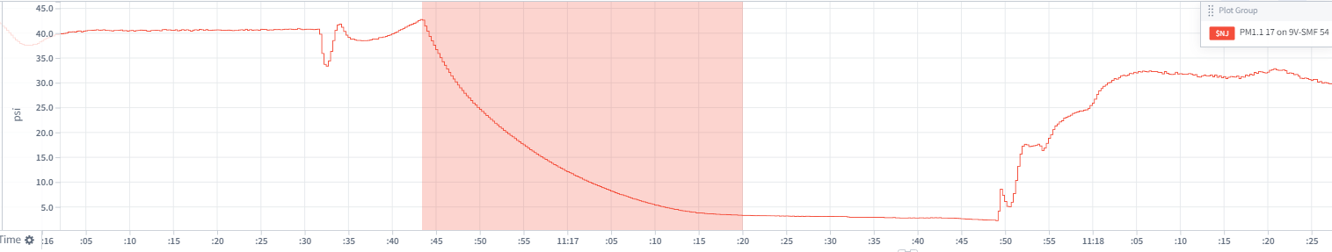
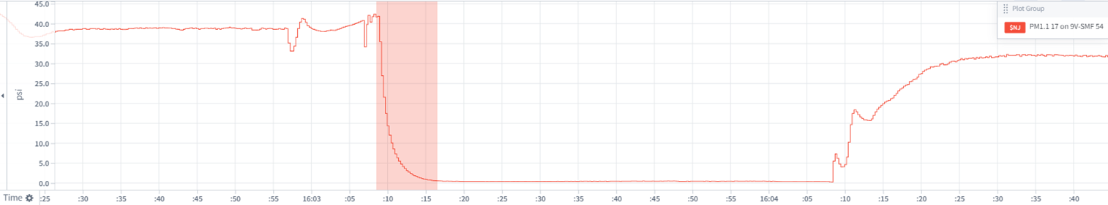
A350 ATA 36 : PCE Leakage Monitoring
Leaky Precooler - Evidence
MSN 54 SIA
PCE Depressurization Event
(Healthy PCE)
PCE Depressurization Event
(Leaky PCE)
Bigger depressurization slope in leaky PCE

Slide 7
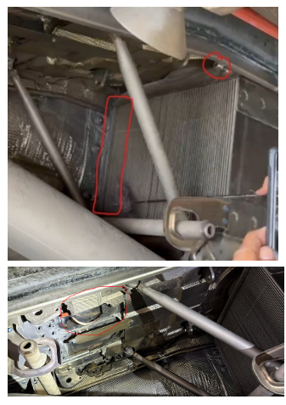
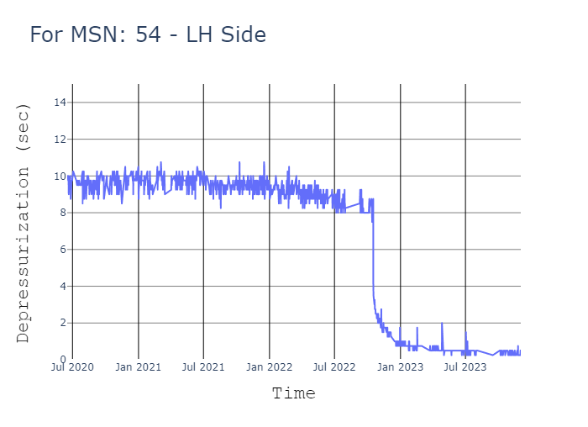
A350 ATA 36 : PCE Leakage Monitoring
Leaky Precooler - Evidence
Validation of ASR algorithm:
As explained in the system description section, the work performed for ASR focuses on developing an algorithm which captures depressurization time after engine start.
In normal conditions, depressurization time is >6sec
For abnormal cases when PCE is expected to be leaky, considering OPSOV, MPV, Engine Starter Valve are good and air pipes are not leaking, the depressurization will be very fast (<1sec).
As visible in Fig1, the algorithm have predicted leaky precooler from the Q1 2023 for MSN 54 of Singapore Airline (with sudden drop in depressurization time)
Early this year the hardware had be inspected and we found actual leakage in pre-cooler also thermal blanket around PCE is damaged.
This is a very good validation for proving the algorithm is working as expected.
After detection of leaky precooler the hardware is replace with new PCE on 13th Jan 2024
Fig1
Fig2

Slide 8
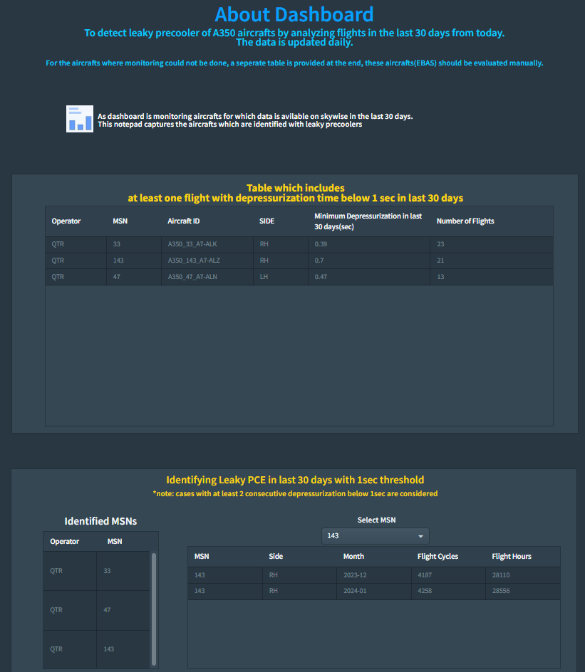
A350 ATA 36 : PCE Leakage Monitoring
Existing monitoring approach and how its useful
With the proven usability of algorithm and after discussions with airline (SIA).
Singapore airline is interested to continuously monitor the fleet performance.
In-line with this ideas, ASR work have been extended to develop a data analysis pipeline to continuously monitor the PCE performance.
Following is the dashboard which shows probably leaky precooler information.
  Approach
    Run the pipeline daily
    Analyze flights from past 30 days for which sensor data is available on Skywise
    Highlight the aircrafts with probably leaky precoolers
Dashboard
Notes:
SPM algorithm will improve the monitoring performance by tuning the threshold and by tuning the logic.

Slide 9
A350 ATA 36 : PCE Leakage Monitoring
Need for monitoring at SPM
Why is there a need for SPM monitoring?
Operating with leaky precooler can damage other components inside pylon, especially in case of engine fire.
Singapore Airline is interested to perform continuous monitoring of the entire fleet.
  Discussions with Qatar airline is in progress
The usability and validation of algorithm have already been demonstrated with ASR.
No new sensor or hardware change is required for implementation of the proposed approach.
Algorithm is very good at this point, multiple validations have been performed to validate by manually checking the depressurization time from time-series sensor data
SPM monitoring will improve the prediction accuracy by tuning the threshold and logic.
SPM monitoring can cover the complete fleet of aircrafts
SPM will enable notification to airline in case of leaky precooler detection.

Slide 10
A350 ATA 36 : PCE Leakage Monitoring
SAR Data Parameters
Channel | Parameter ACU | Description | Recording frequency (Hz) | Type
17 | PM1.1 | EBAS 1 Manifold Pressure (PM1) | 4 | Float
17 | PM1.2 | EBAS 2 Manifold Pressure (PM1) | 4 | 0
17 | PM2.1 | EBAS 1 Manifold Pressure (PM2) | 4 | 0
17 | PM2.2 | EBAS 2 Manifold Pressure (PM2) | 4 | 0
17 | HP6PR.1 | HP6 pressure (from engine 1) | 4 | 0
17 | HP6PR.2 | HP6 pressure(from engine 2) | 4 | 0
17 | OPSOVPOS.1 | OPSOV 1 position | 1 | Boolean
17 | OPSOVPOS.2 | OPSOV 2 position | 1 | Boolean
17 | PBPRENG.1 | PB Pressure engine1 | 4 | 0
17 | PBPRENG.2 | PB Pressure engine 2 | 4 | 0
17 | MPVTMCUR.1 | Current to MPV 1 Torque motor | 4 | 0
17 | MPVTMCUR.2 | Current to MPV2 Torque motor | 4 | 0
17 | MPVPOS.1 | MPV 1 position | 1 | Boolean
17 | MPVPOS.2 | MPV 2 position | 1 | Boolean
17 | APUBVPOS:1 | APUBV position fully closed | 1 | Boolean
17 | APUBVPOS:2 | APUBV position fully closed | 1 | Boolean

Slide 11
A350 ATA 36 : PCE Leakage Monitoring
✔
Summary of the key points:
PCE Leakage Monitoring algorithm have been developed for ASR.
The algorithm is validated with real leakage in SIA MSN 54(Left Engine PCE) and QTR MSN 132 (Right Engine PCE).
Singapore airline is interested for continuous monitoring of the A350 fleet.
Similar algorithm can be developed for SA and LR aircrafts.
A strong use case for SPM applicability
Further improvements in the algorithm can be implemented to improve the detection accuracy.
Conclusion:
Conclusion on scoping: GO / NO-GO
  GO
Mandatory actions to be performed before feasibility study:
  Note: SAR17 is available only for <40% of the fleet
  Check with airlines for SAR17
    Start with JAL airline
    H Rasolofo (contact person in JAL)
  Airlines (JAL, FWI, CAL, UAE, EVE, ITY, QFA, SAS , SCS)
✔
Notes:
DAVID DECOUCHON
9:14 PM
H Rasolofo
LUIS GUILLERMO AMESTY
9:14 PM
These are:
- JAL
- FWI
- CAL
- UAE
- EVE
- ITY
- QFA
- SAS
- SCS
YVES DUPONT
9:14 PM
# 160 A/C provide the SAR 17
so more 30 than 40%

Slide 12
Thank You !

Slide 13
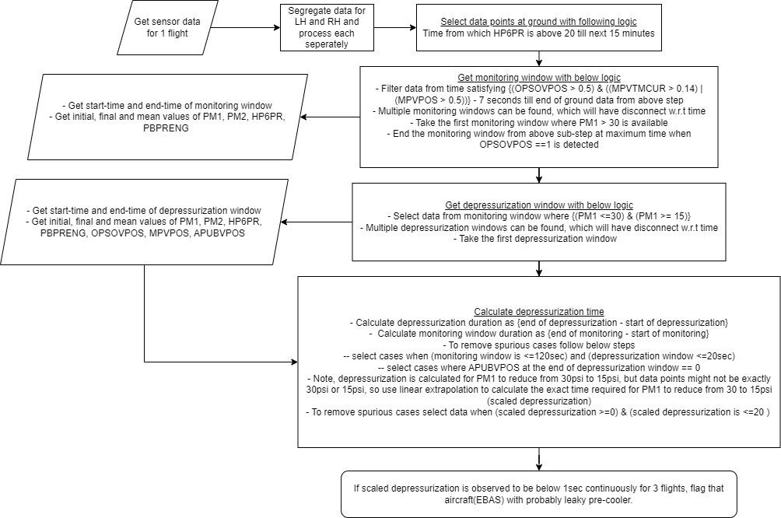
A350 ATA 36 : PCE Leakage Monitoring
Logic - Flow Chart
Start
Check if this slide is required?

